Slide 1

Distributed reliable key-value store for the most critical data of a distributed system
Wenzhe Liu

Slide 2
Outline
Introduction
Features
Application Scenario
Architecture
Compare with Zoo Keeper
Stress Test
A CRMS implementation with etcd

Slide 3
What’s etcd
Distributed Observable
Map<string, []byte>
An observable highly-available key value store for shared configuration and service discovery
Distributed coordinator
Written by CoreOS with Go language
Apache 2.0 license
Simple: well-defined, user-facing API (gRPC)
Secure: automatic TLS with optional client cert authentication
Fast: benchmarked 10,000 writes/sec
Reliable: properly distributed using Raft

Slide 4
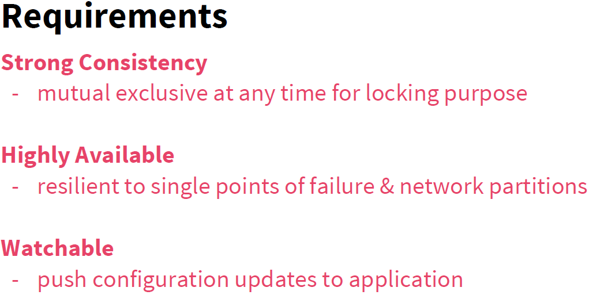

Slide 5
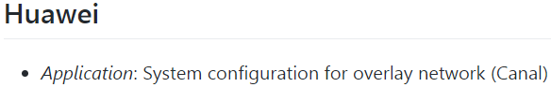

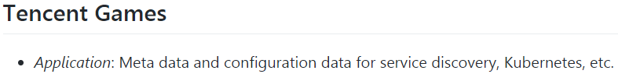



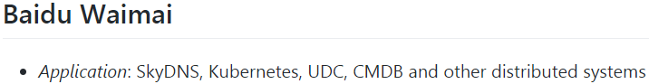

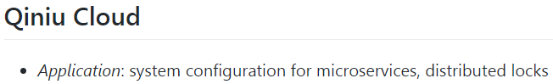



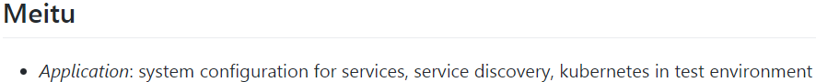


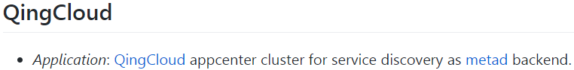

Users

Slide 6
Outline
Introduction
Features
Application Scenario
Architecture
Compare with Zoo Keeper
Stress Test
A CRMS implementation with etcd

Slide 7
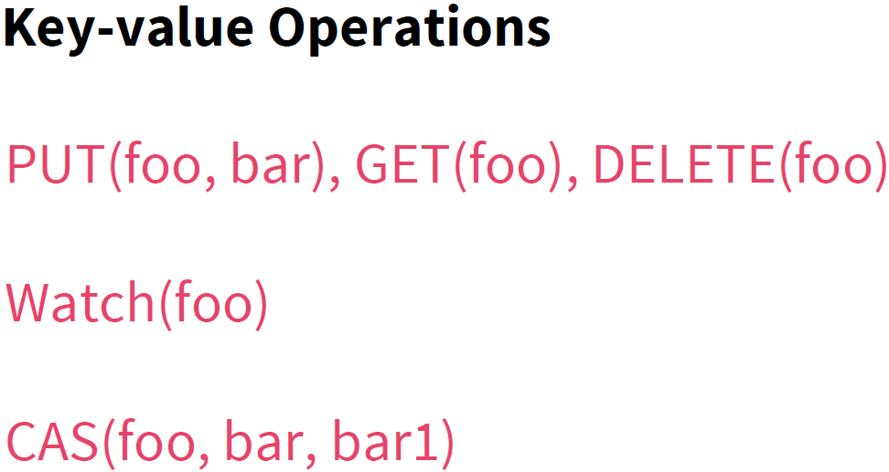

Slide 8
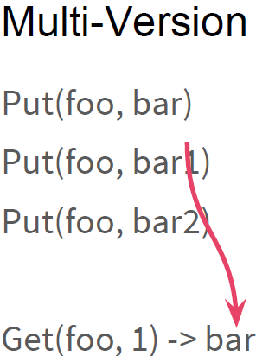
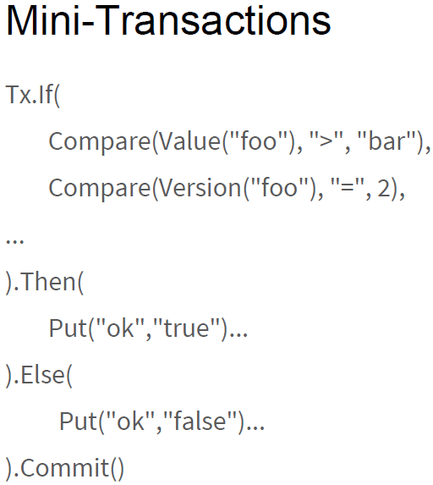

Slide 9
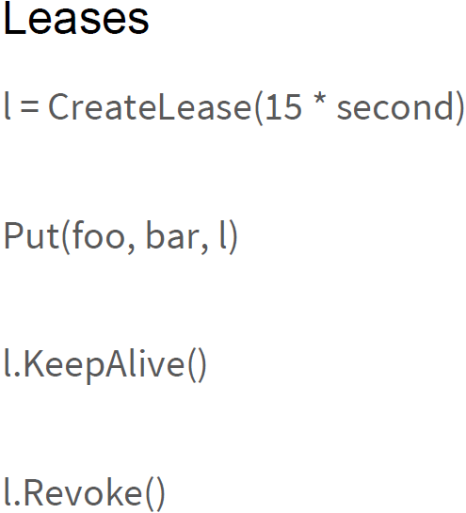
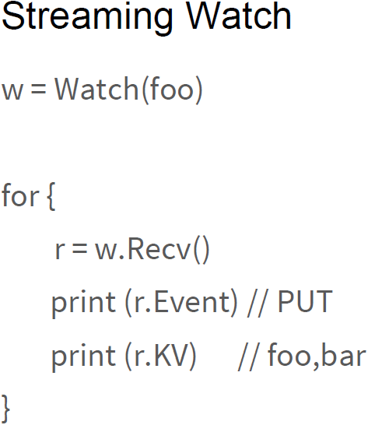

Slide 10
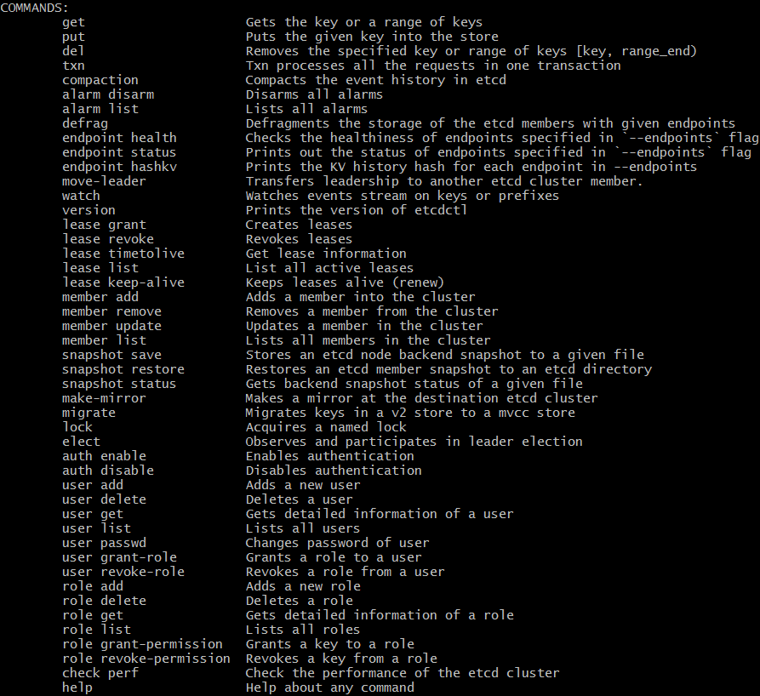
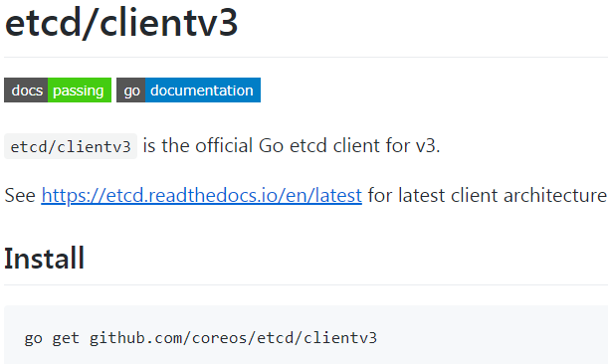
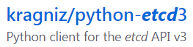
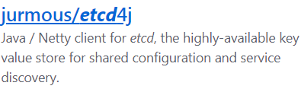

Client
Command line client: etcdctl
demo
Go client (official)

Slide 11
Outline
Configure Management
Service Discovery
Introduction
Features
Application Scenario
Architecture
Compare with Zoo Keeper
Stress Test
A CRMS implementation with etcd
Load Balance
Notify & Coordination
Leader election
Cluster monitor
Distributed Message Queue
Distributed Lock
Publish / Subscription

Slide 12
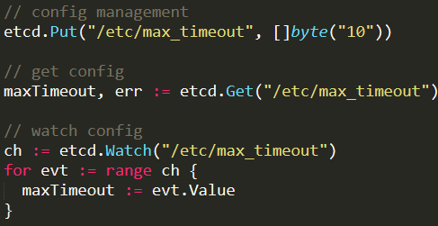
Observable Configure management
client
Update config
Etcd cluster
Etcd
/etc/…
Etcd
/etc/…
Etcd
/etc/…
watch
client
client
client

Slide 13
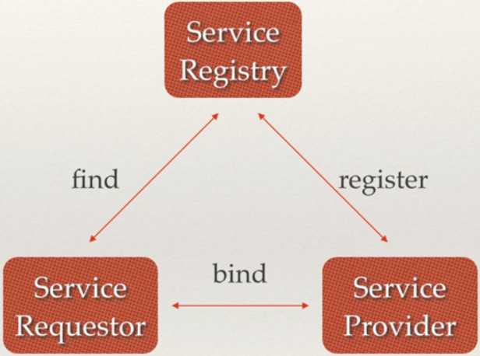
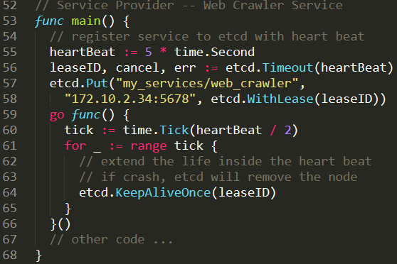
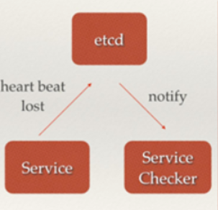
Service Discovery
Service Provider
etcd

Slide 14
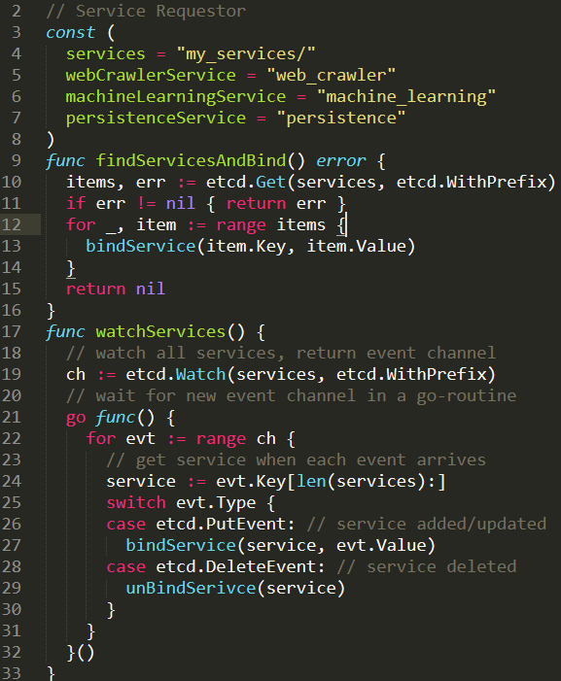
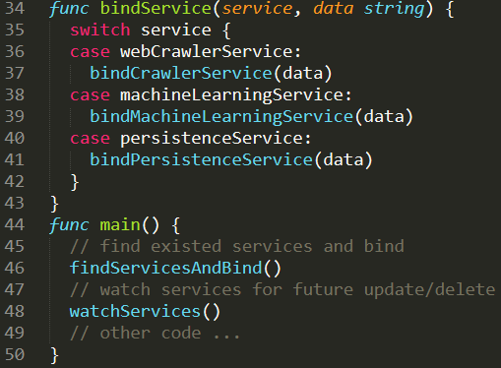
Service Requestor

Slide 15
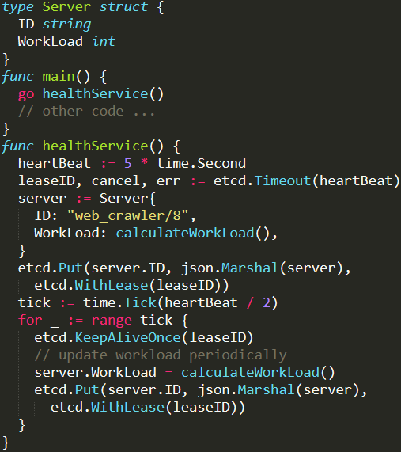
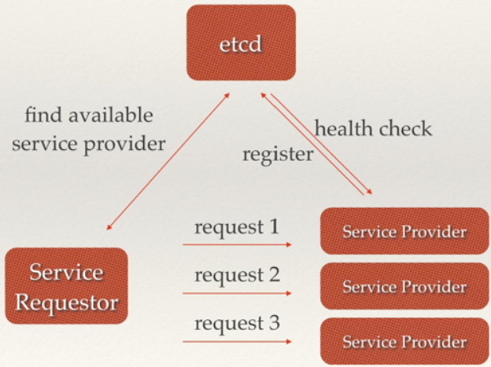
Service Provider
Load balance

Slide 16
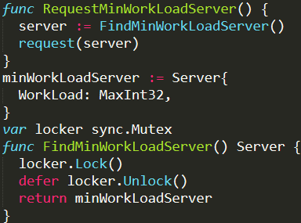
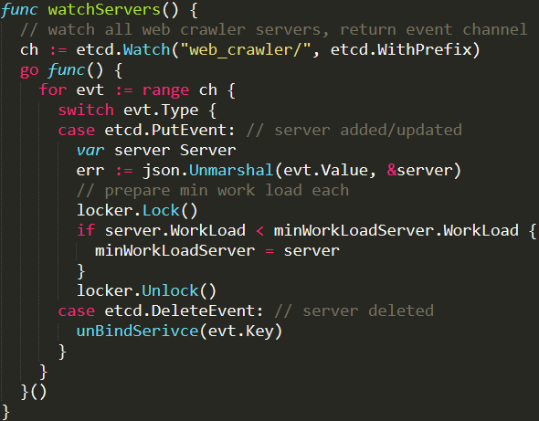
Load balance
Service Requestor (share memory, need lock)
global var

Slide 17
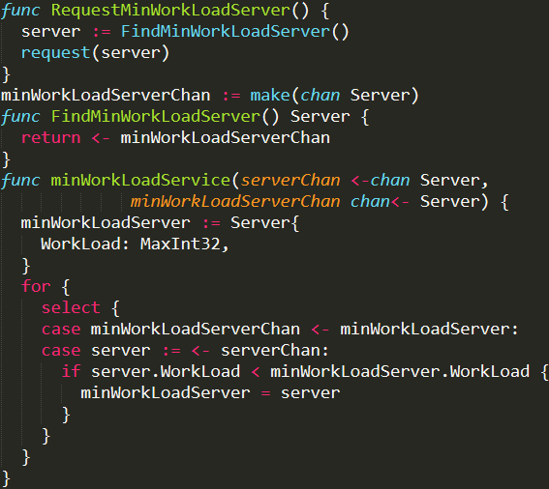
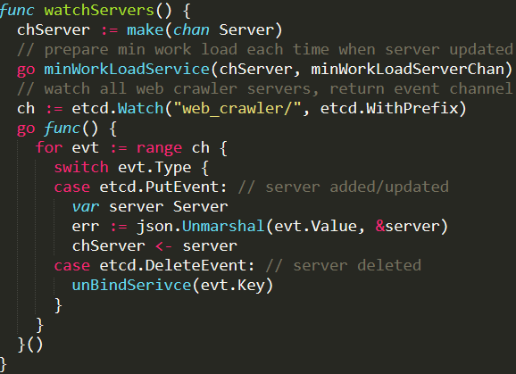
Load balance
Service Requestor (communicate by channel instead of sharing memory, no lock)
Only share chan
local var
No care how to use,
just sent to chan
Reactive Programming
Server Chan
Min Work Load Service
Min Work Load
Server Chan

Slide 18
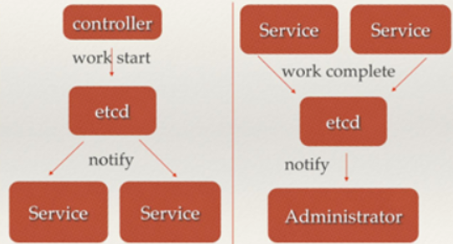
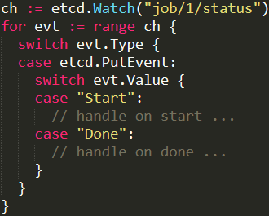
Notify and coordination

Slide 19
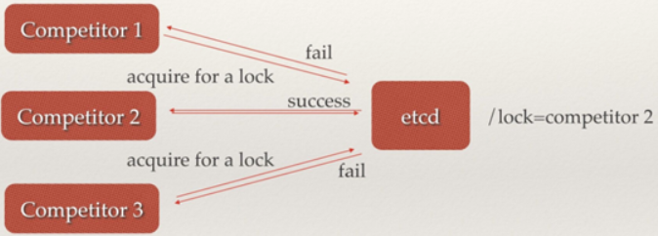
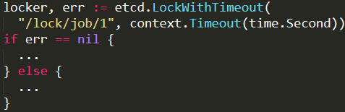
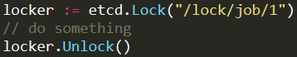
Distributed Lock
After fail, watch the lock until unlock and then compete again
Block if locked by others

Slide 20
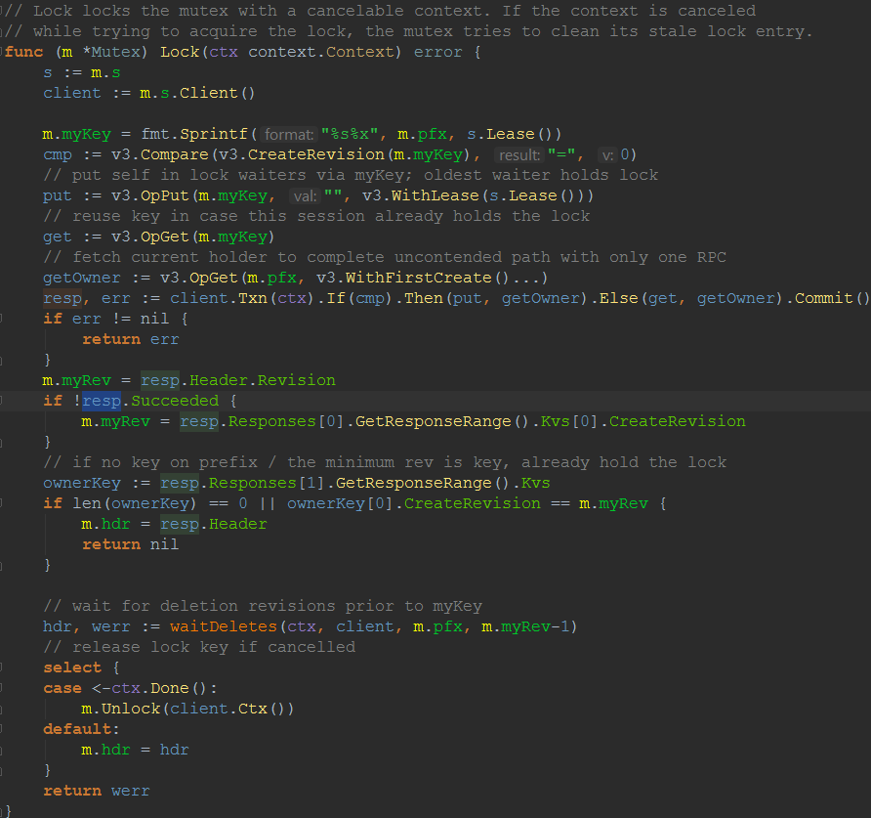
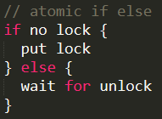
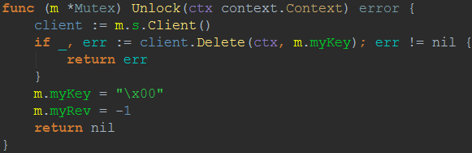
Source code in etcd for lock
==

Slide 21
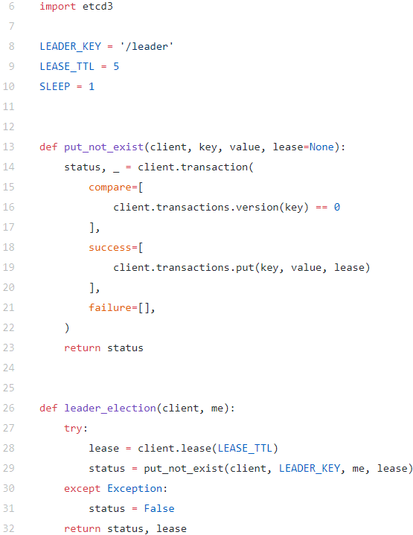
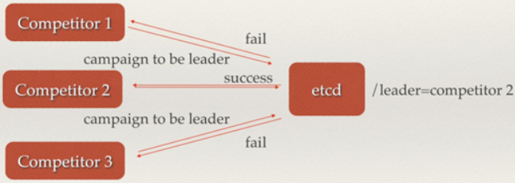
Cluster monitor and leader election

Slide 22
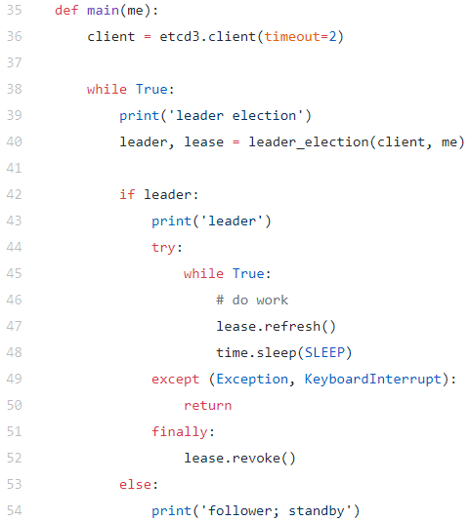
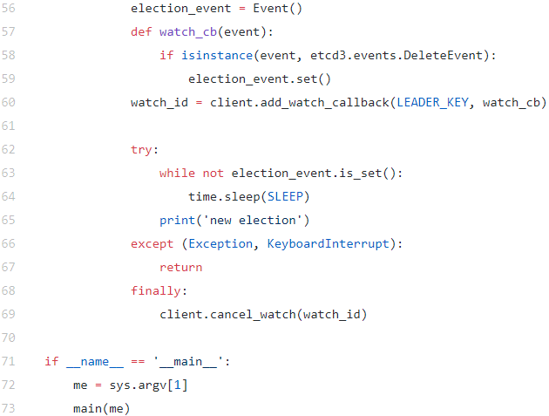

Slide 23
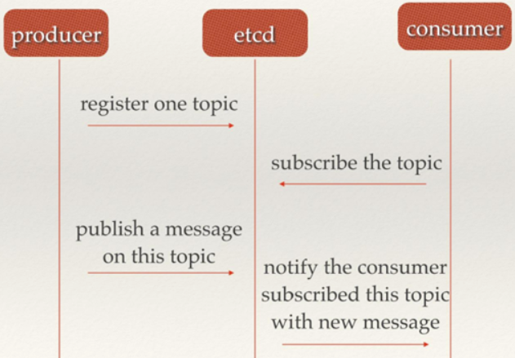
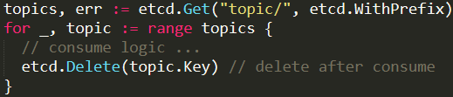
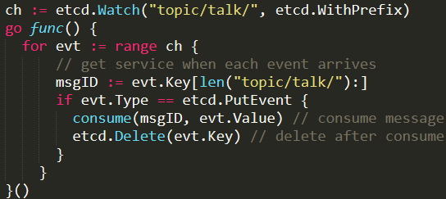
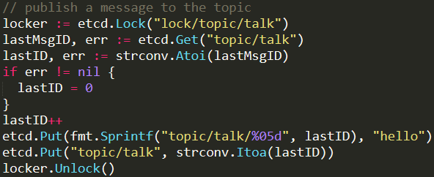
Publish / Subscription, Distributed Message Queue
Consumer (pull mode)
Consumer (push mode)
After all, it is NOT design as a
professional message queue
Producer

Slide 24
Outline
Introduction
Features
Application Scenario
Architecture
Compare with Zoo Keeper
Stress Test
A CRMS implementation with etcd

Slide 25
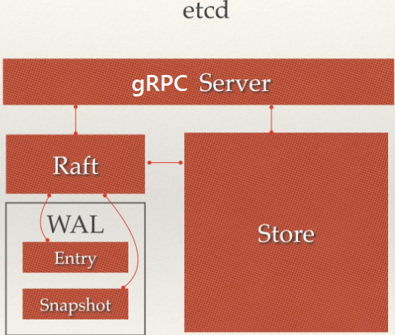
Raft: refer to the pdf attached
WAL: Write Ahead Log

Slide 26
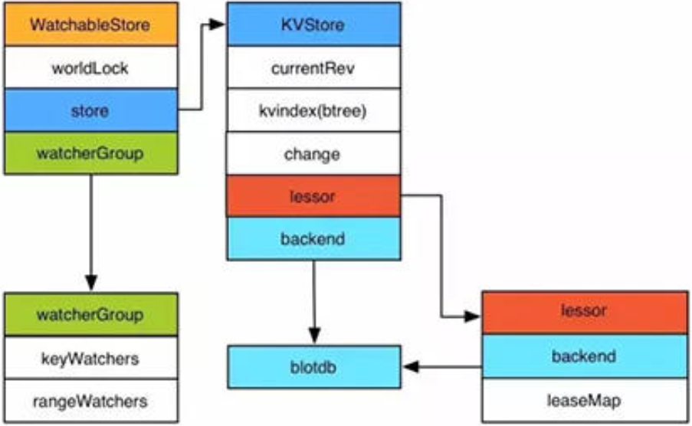
Etcd V3 store

Slide 27
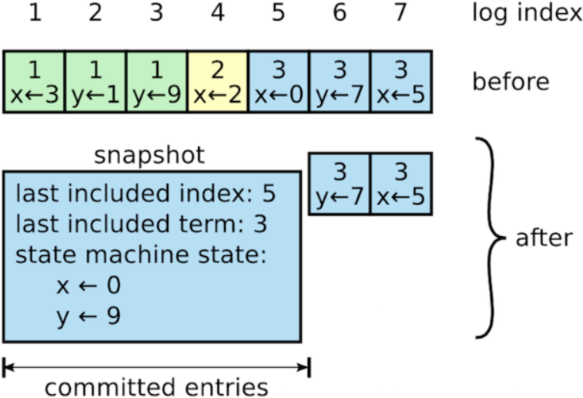
Snapshot: Log compress

Slide 28
Outline
Introduction
Features
Application Scenario
Architecture
Compare with Zoo Keeper
Stress Test
A CRMS implementation with etcd

Slide 29
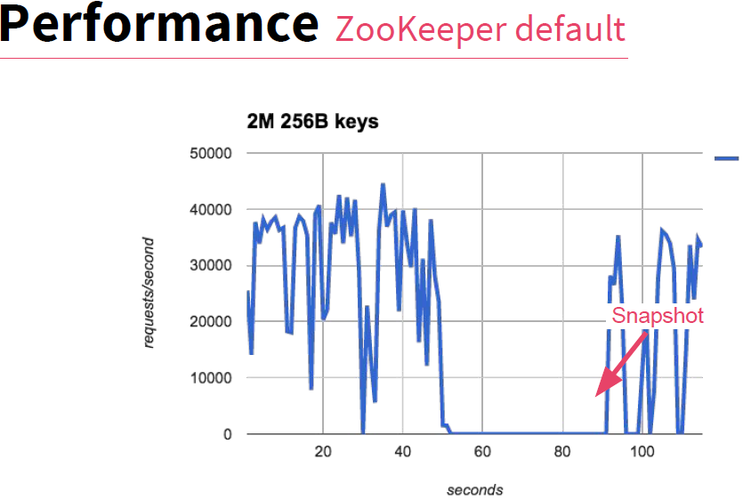
Zoo Keep is the similar to etcd, but older, written by Java and proxy is Zab

Slide 30
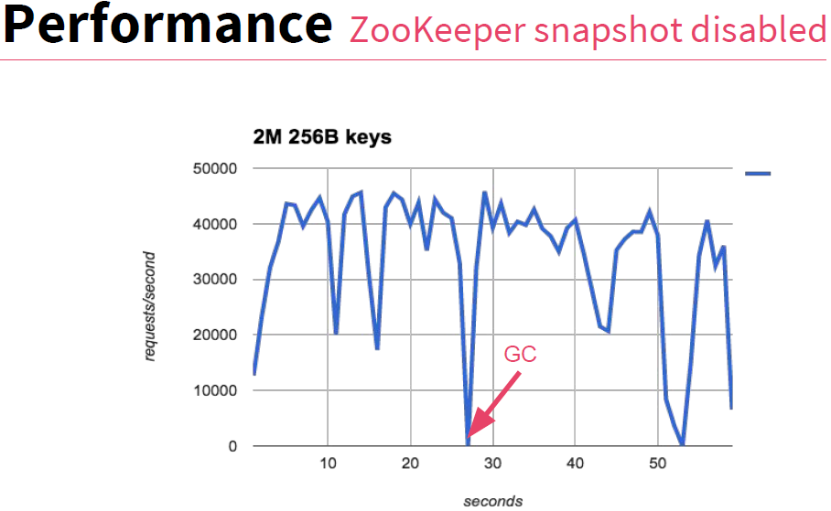

Slide 31
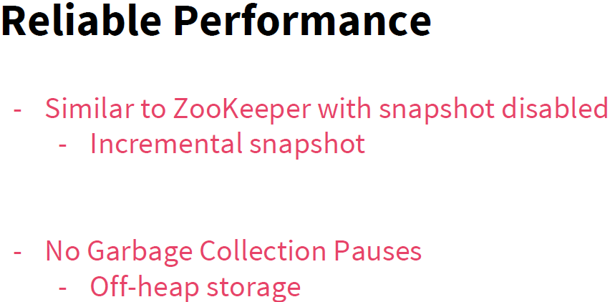

Slide 32


zk
etcd
zk
etcd
Why etcd is more smooth? ---- Thanks to Go’s intelligent Stack/Heap allocation strategy!
As Go uses the same GC algorithm with Java, but Go’s Stack/heap allocation strategy is much more intelligent.
In Java, when you new an object (except basic type), it will allocate to heap, GC will check it and work load hard.
In Go, the intelligent compiler will try to allocate to stack if it is safe to be there. So GC’s work load is greatly decreased.

Slide 33


Slide 34
Outline
Introduction
Features
Application Scenario
Architecture
Compare with Zoo Keeper
Stress Test
A CRMS implementation with etcd

Slide 35
High Concurrency Stress Test
Test way:
n = 10000, 100000, 150000, 180000
for i := 0; i < n; i++ {
go func(k, v string) {
Start n go-routines to
simulate n concurrencies
at the same time
Etcd put k, v
Etcd get k and verify
Etcd delete k
Etcd get k and verify
}(fmt.Sprint("key_", i), fmt.Sprint("value_", i))
}
Summary:
1. etcd is not suitable for high concurrency, fast and large data updating.
2. when more than n = 10000 updates from 10000 go-routines, some will fail with too many requests, can fix by retry.
3. when retry count up to 5, still cannot support n = 100000.
4. retry count up to 10 can support 100000, time cost: 46s (mongodb takes 9s in 4 parallel sessions)
5. retry count up to 20 can support 150000 but not always success
6. retry count up to 40 still cannot support 180000, in this time both etcd client and cluster crash.

Slide 36
Outline
Introduction
Features
Application Scenario
Architecture
Compare with Zoo Keeper
Stress Test
A CRMS implementation with etcd

Slide 37
DB: data base server
DC: distributed coordinator
MQ: message queue server
CRMS Implementation Solution (GoCRMS):
DB: etcd, MQ: etcd, DC: etcd
Server
Server
Advantage:
single technology
can watch everything
Configure watchable
No port requested for each server(host/leaf)
Decentration
No single point of failure
Disadvantage:
throughput
performance
cost space (etcd stores modify history)
Server
etcd
etcd
Client
etcd
Server
Server
Server
Slurm submit 50000 jobs costs 20 minutes
But fail to submit 40000 jobs parallel at the same time as its throughput limit
GoCRMS Submit 20000 jobs costs: 10 seconds
Notes:
Db: etcd, Mq: etcd
Advantage: 1. single tech 2. can watch everything
Disadvantage: 1. throughput 2. performance 3. need more space

Slide 38
DB: data base server
DC: distributed coordinator
MQ: message queue server
GoCRMS Improvement Suggestion:
DB: Mongo, MQ: NSQ, DC: etcd
Server
Server
Advantage:
can watch everything
Configure watchable
No port requested for each server(host/leaf)
Decentration
No single point of failure
High throughput
High performance
Less space
Disadvantage:
Introduce more technologies
etcd
mongo
nsq
Server
Client
etcd
mongo
nsq
Server
etcd
mongo
nsq
Server
Server
Coordinator
Coordinator is the leader elected from all available servers
Notes:
Db: etcd, Mq: etcd
Advantage: 1. single tech 2. can watch everything
Disadvantage: 1. throughput 2. performance 3. need more space

Slide 39


Demo gocrms (Linux/Windows)
Written in Go

Slide 40



Demo gocrms: start service in each server (host/leaf)
start a daemon service:
crmsd –name leaf_2

Slide 41


Demo gocrms: submit job

Slide 42




Demo gocrms: get

Slide 43



Demo gocrms: kill

Slide 44



Demo gocrms: wait

Slide 45
Summary
Distributed reliable key-value store for the most critical data of a distributed system
Distributed coordinator
Watchable

Slide 46
Reference:
etcd interpretation application scenario implement principle
寻找一种易于理解的一致性算法（扩展版）
Etcd 架构与实现解析
Zookeeper vs etcd vs Consul

Slide 47


